Slide 1
IBRD CREDIT SCORECARD PREDICTIVE ENGINE
Hardefa Rogonondo
- Machine Learning Process -

Slide 2
OUTLINE
01
02
03
PROBLEM FORMULATION
SOLUTION & PIPELINE
GLIMPSE OF RESULTS
What’s the problem formulation for the business?
Let’s see how we will tackle this problem
How our solution works?

Slide 3
HELLO
Name : Hardefa Rogonondo
Occupation : Data Scientist
GitHub : hardefarogonondo
LinkedIn : Hardefa Rogonondo

Slide 4
PROBLEM FORMULATION
01
What’s the problem for the business?

Slide 5
MAIN PROBLEMS
PREDICTING BAD LOANS
USER-FRIENDLY API
Identifying and predicting 'bad' loans in a banking institution's portfolio to mitigate financial risk. This problem is tackled by building a machine learning model using Logistic Regression.
Developing an Application Programming Interface (API) where a user can input borrower information and immediately get a risk score. The backend of the API utilizes the credit risk prediction model and the frontend is built to be intuitive and easy to use.

Slide 6
UNDERSTANDING SCORECARD
WHAT IS A SCORECARD?
WHY USE A SCORECARD?
Scorecards are decision-making tools used in various industries, including finance. They help to evaluate and compare different aspects based on certain predefined metrics.
Scorecards provide a standardized way to assess risk. They convert complex data into a simple score, aiding in making informed decisions.

Slide 7
OUR DATASET
DATASET DATE
SOURCE
DATASET SHAPE
COLUMN TYPES
Last Updated:
June 21, 2023
World Bank Open Data
9012 Rows
33 Columns
Most of it are administrative date of the loans

Slide 8
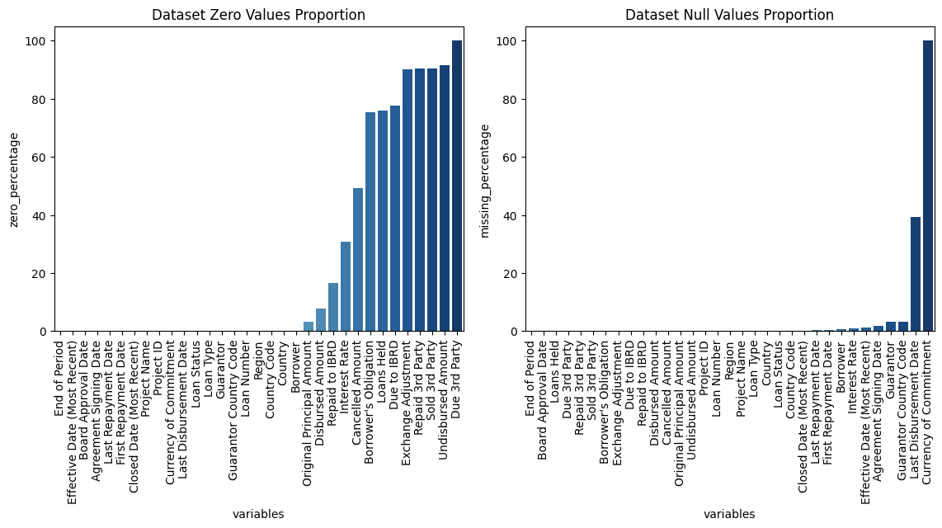
DATA PREPARATION
We clean the data by dealing with missing values appropriately. In our case, any column with more than 50% missing values is dropped, as they aren't adding much information for our journey.

Slide 9
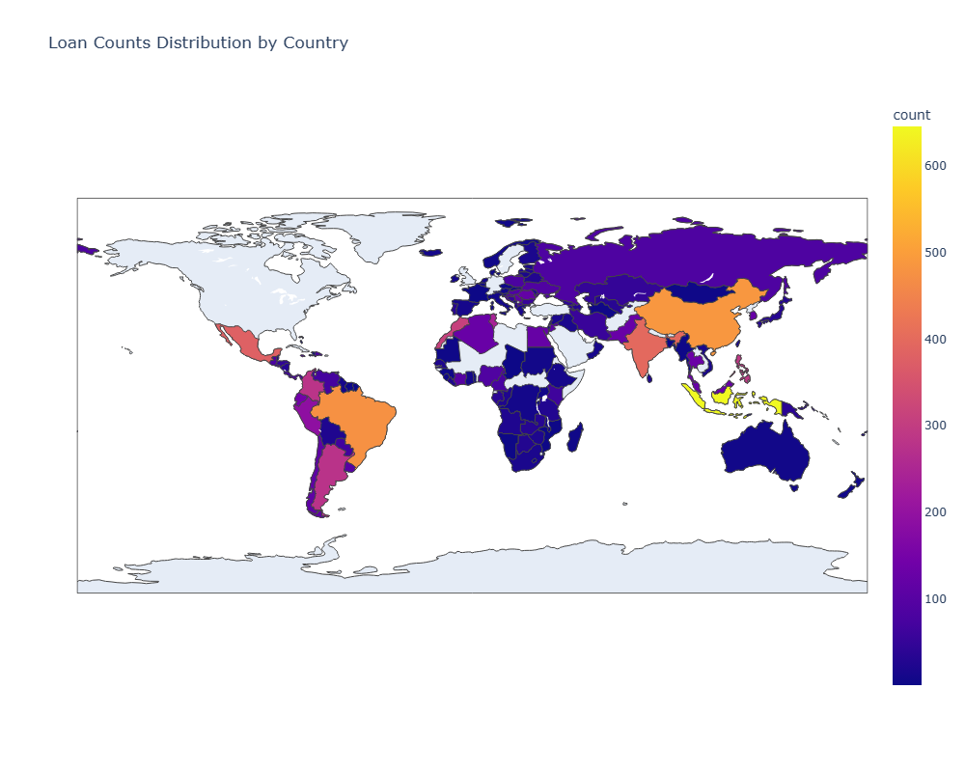
EXPLORATORY DATA ANALYSIS
Explore the global distribution of loans using this world map. Each country is colored according to the number of loans it has received. This broad view helps us understand the geographical spread of our data.

Slide 10
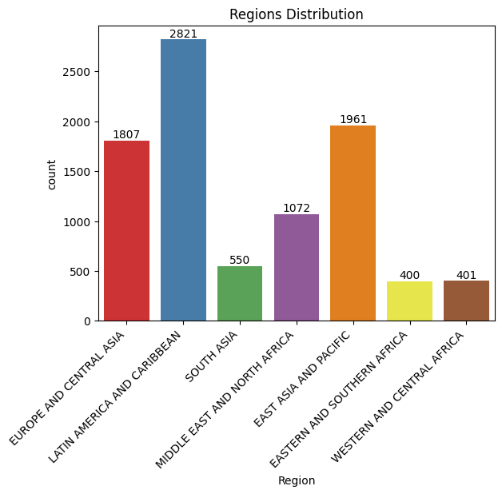
EXPLORATORY DATA ANALYSIS
Let's take a closer look at the loan distribution within different regions. Some regions might have more loans than others, and this could be significant in our journey.

Slide 11
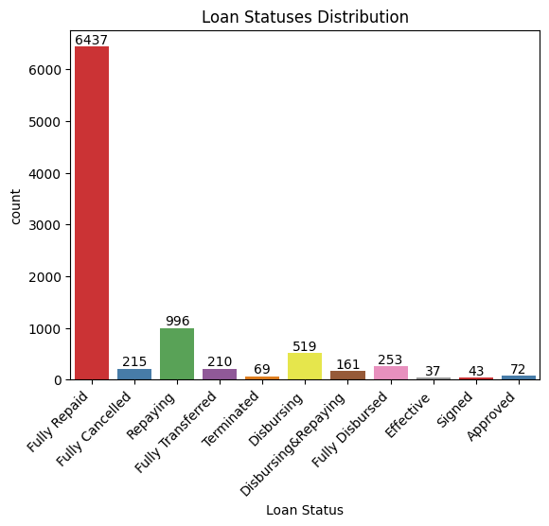
EXPLORATORY DATA ANALYSIS
Now, let's take a look at the distribution of loan statuses. Each status provides us with different insights into the repayment of the loan, giving us clues about 'good' and 'bad' loans.

Slide 12
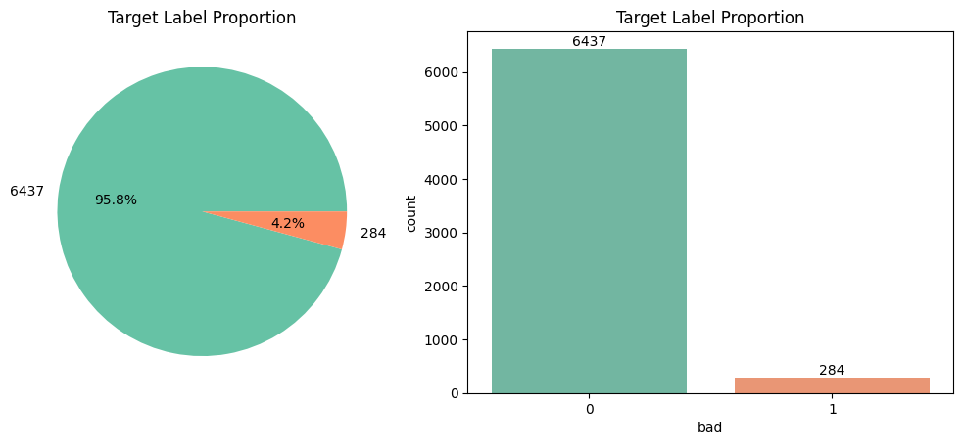
EXPLORATORY DATA ANALYSIS
From the loan statuses, we create labels for our loans. Loans that are 'Fully Cancelled' or 'Terminated' are labeled as 'bad', and 'Fully Repaid' loans are labeled as 'good'. This labeling will guide our model in its predictions.

Slide 13
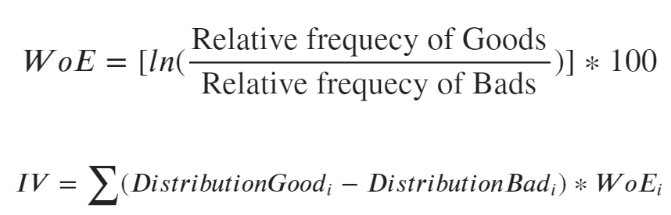
FEATURES ENGINEERING
WEIGHT OF EVIDENCE
INFORMATION VALUE
WoE helps us understand the predictive power of each category within a feature. It's like a compass guiding us to valuable categories.
IV quantifies the amount of information each feature brings to the model.

Slide 14
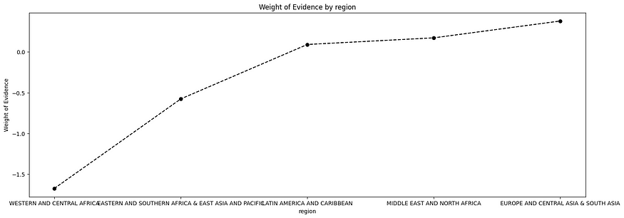
FEATURES ENGINEERING
Let's take a look at an example graph demonstrating the WoE and IV of our features. Understanding these values helps us fine-tune our model and predict more accurately by binning the features into categories.

Slide 15
SOLUTION & PIPELINE
02
How will we solve the business problem?

Slide 16
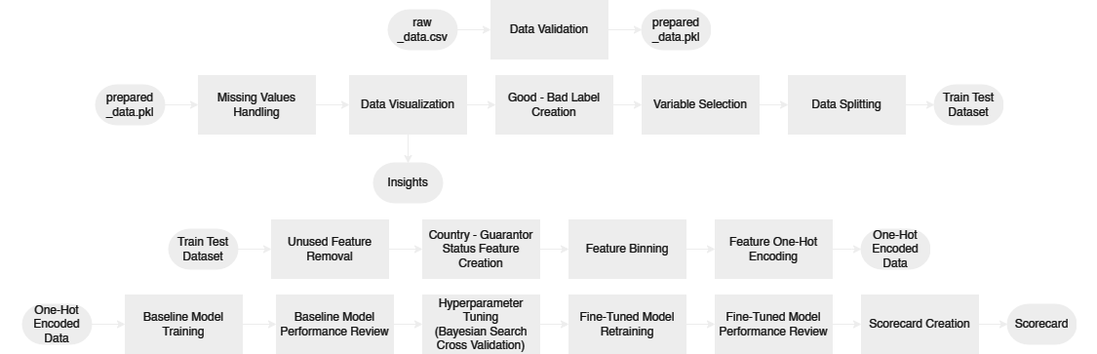
DEVELOPMENT PIPELINE
Our development pipeline streamlines the journey from data preparation through to model evaluation. Starting with data cleanup, we proceed to exploratory data analysis and preprocessing, followed by feature engineering where new features are created, binned, and encoded. The final leg of our journey is modeling and evaluation, where we train, fine-tune, and assess our Logistic Regression model. This methodical process ensures we extract maximum insights and predictive power from our data.

Slide 17
GLIMPSE OF RESULTS
03
How our solution works?

Slide 18
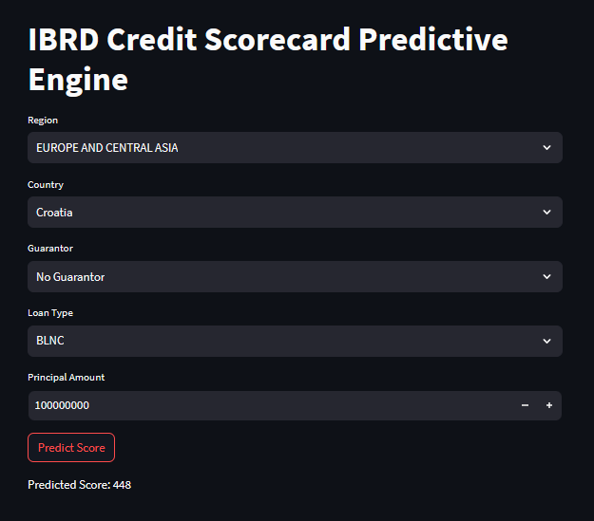
STREAMLIT FRONTEND
Streamlit is our chosen tool for creating an interactive and user-friendly frontend. It allows us to build an intuitive interface where users can input loan details and receive a risk score in return. The screenshot showcased here displays our application's seamless design and functionality, demonstrating how easy it is for users to get loan risk predictions instantly.

Slide 19
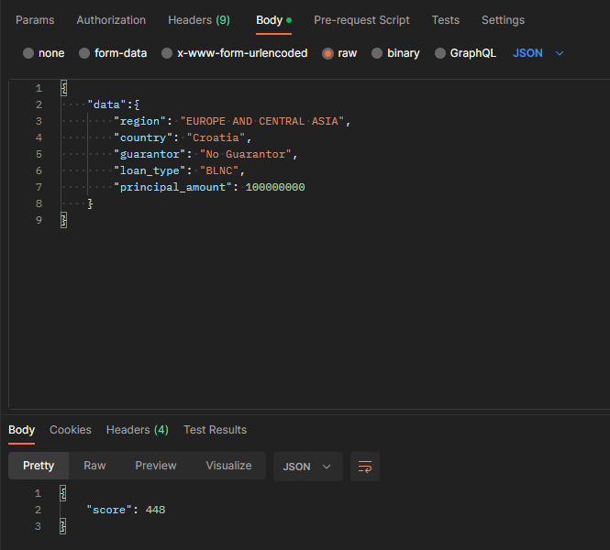
FASTAPI BACKEND
FastAPI is our robust framework of choice for building the application's backend. It's responsible for taking user inputs from the frontend, processing them through our credit risk model, and returning a risk score. The screenshot here, taken from Postman, demonstrates how our backend API can accept these inputs and deliver outputs efficiently and accurately. This ensures our application remains responsive and reliable for users seeking loan risk predictions.

Slide 20
DEMO TIME

Slide 21
THANK YOU

